Slide 1
CSLAB – Final Delivery
1210804 – André Gonçalves
1201458 – Jorge Moreira

Slide 2
Safety and Reliability Analysis
Tracebility
Notes:
SISTEMA DE UMA SALA ACTUATORS SÃO OS LEDS E MOTOR

Slide 3
Improvements made to the system
Logic on the blinds
Assembly Functionality
Real Time Tasks
Smart Data Model

Slide 4
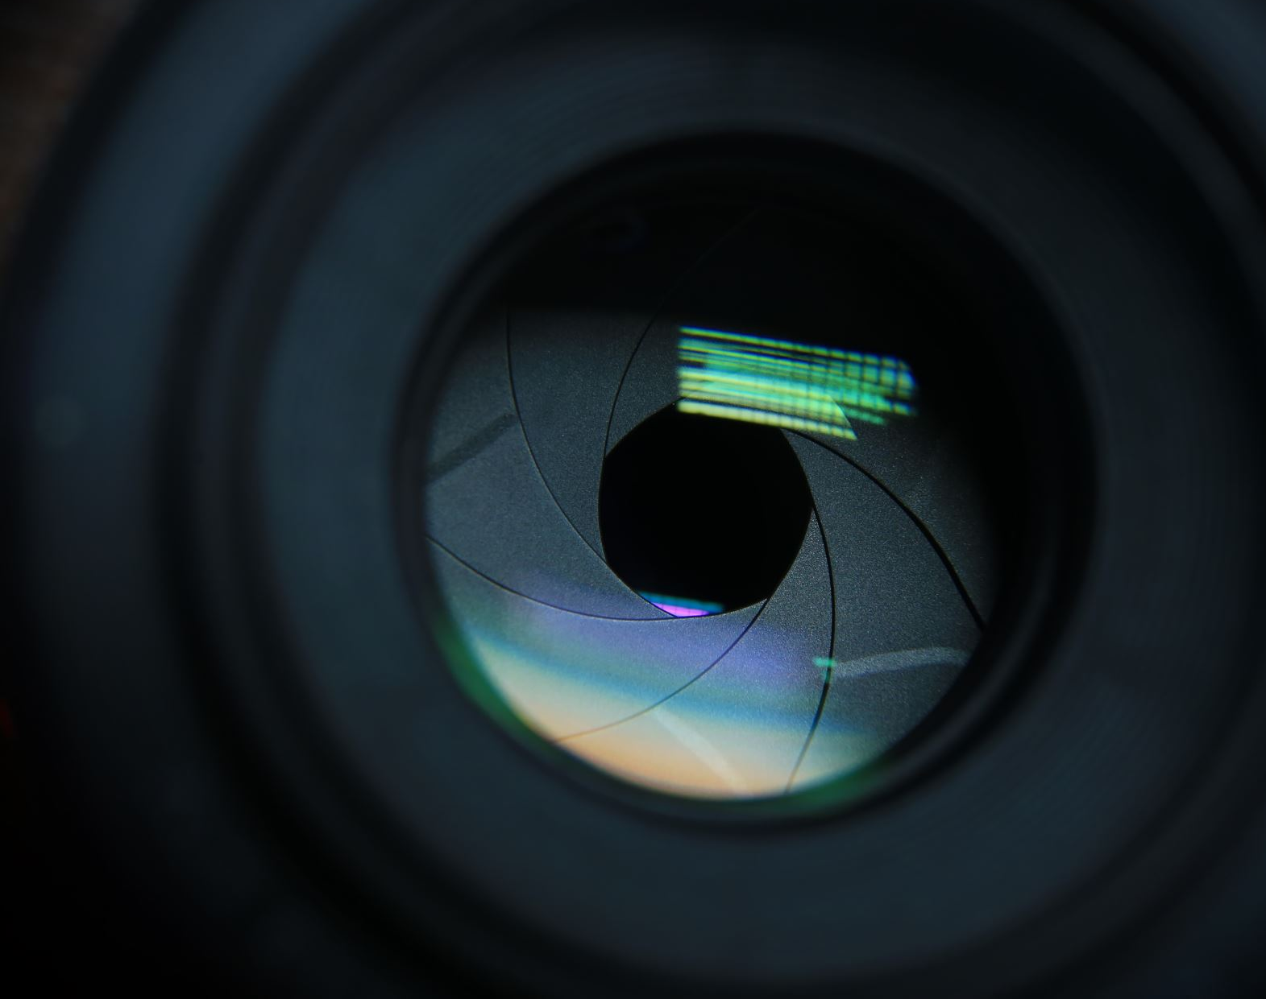
Demo
Notes:
SISTEMA DE UMA SALA ACTUATORS SÃO OS LEDS E MOTOR

Slide 5
Teamwork Management

Slide 6
Teamwork Management

Slide 7

In conclusion…

